Slide 1
Sphinxing it!
Divya Mohan

Slide 2

Who am I?
- Senior Systems Administrator with HSBC
- AWS Community Builder
- Google Season of Docs, 2020 with CERN-HSF
- CNCF Ambassador

Slide 3
Agenda
What is great documentation anyway?
Why do we need yet another tool?
What is Sphinx?
Getting our hands dirty #1
What can I do with Sphinx?
Getting our hands dirty #2

Slide 4
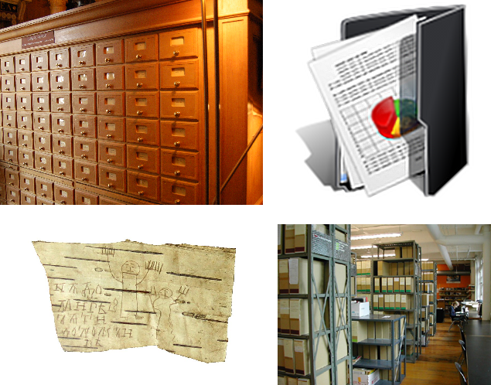
What is great documentation anyway?

Slide 5
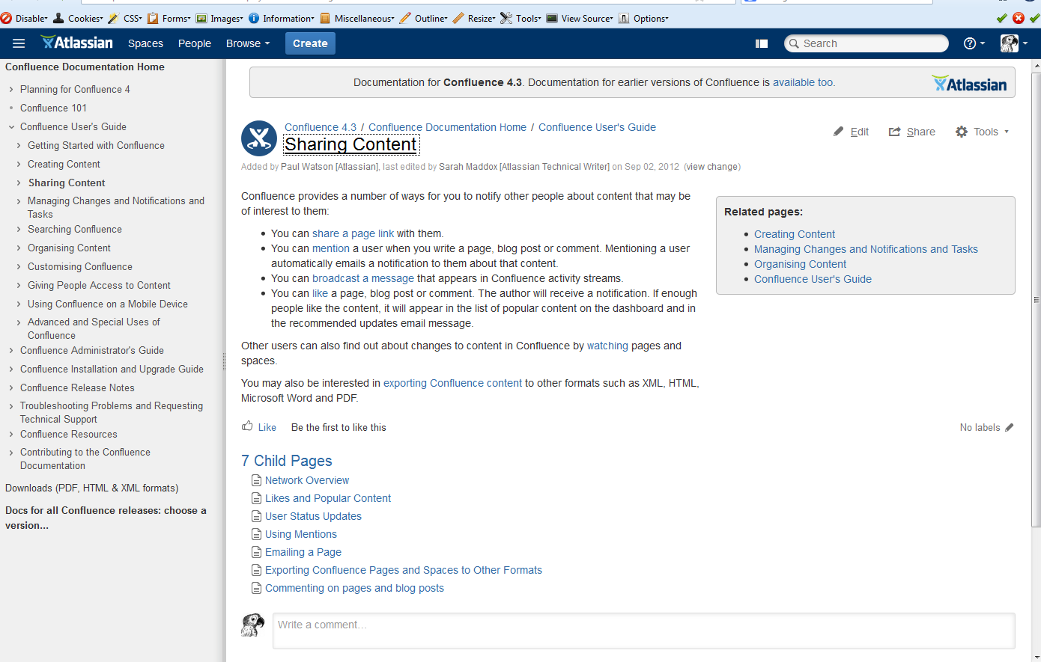
What is great documentation anyway?

Slide 6

Why do we need yet another tool?

Slide 7
What is Sphinx?
Documentation generator
Written by Python community, adopted very widely
Some examples:
Rucio by CERN-HSF
CIRQ
Qiskit
Python documentation

Slide 8
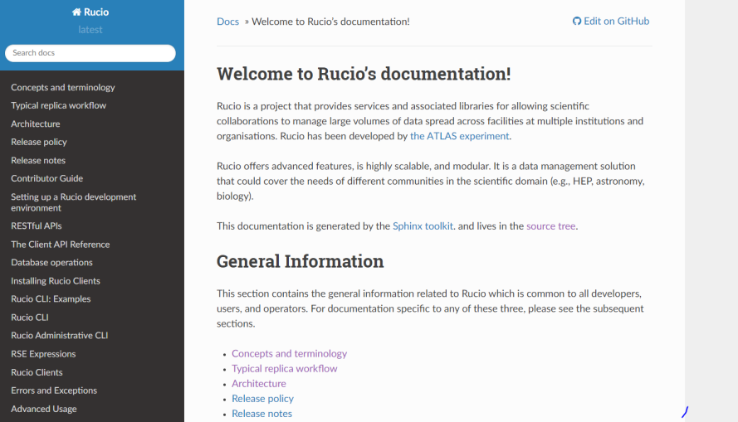
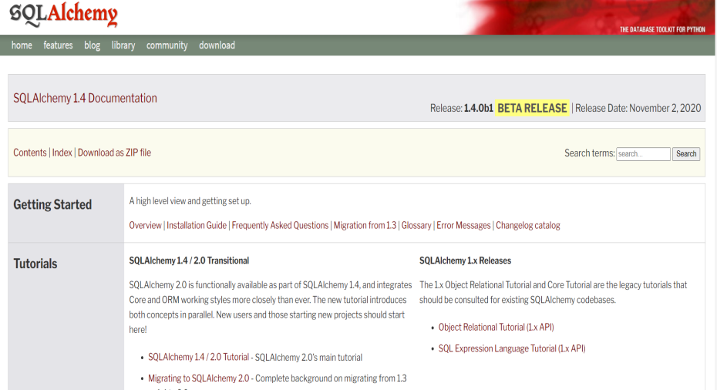
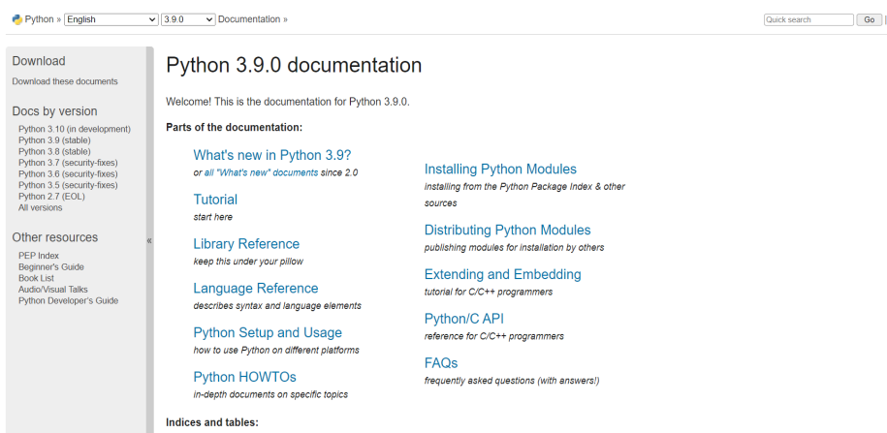
What is Sphinx?

Slide 9
What can I do with Sphinx?
Beautiful API documentation for Python
Different themes available
Can customize with your own CSS files
Can convert reStructured/Markdown files into:
HTML
PDF
Man pages etc.

Slide 10
Resource
Twitter: Divya_Mohan02
Linkedin: https://www.linkedin.com/in/divya-mohan0209

